Slide 1

CHAPTER 8
RELATIONS
Copyright © Cengage Learning. All rights reserved.

Slide 2
SECTION 8.2
Reflexivity, Symmetry, and Transitivity
Copyright © Cengage Learning. All rights reserved.

Slide 3

Reflexivity, Symmetry, and Transitivity
Let A = {2, 3, 4, 6, 7, 9} and define a relation R on A as follows: For all x, y ∈ A,
Then 2 R 2 because 2 – 2 = 0, and 3 | 0.
Similarly, 3 R 3, 4 R 4, 6 R 6, 7 R 7, and 9 R 9.
Also 6 R 3 because 6 – 3 = 3, and 3 | 3.
And 3 R 6 because 3 – 6 = –(6 – 3) = –3, and 3 | (–3).
Similarly, 3 R 9, 9 R 3, 6 R 9, 9 R 6, 4 R 7, and 7 R 4.

Slide 4
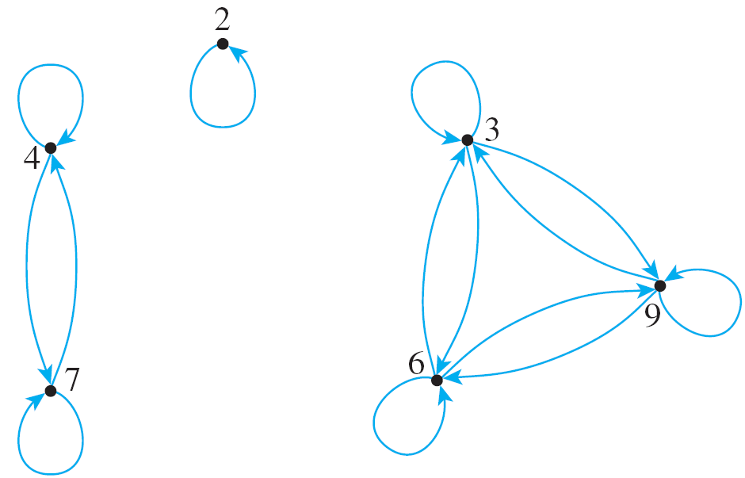
Reflexivity, Symmetry, and Transitivity
Thus the directed graph for R has
the appearance shown at the right.
This graph has three important
properties:
1. Each point of the graph has an arrow looping around
from it back to itself.
2. In each case where there is an arrow going from one
point to a second, there is an arrow going from the
second point back to the first.

Slide 5
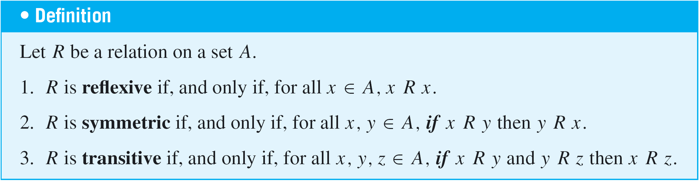
Reflexivity, Symmetry, and Transitivity
3. In each case where there is an arrow going from one
point to a second and from the second point to a third,
there is an arrow going from the first point to the third.
That is, there are no “incomplete directed triangles” in
the graph.
Properties (1), (2), and (3) correspond to properties of general relations called reflexivity, symmetry, and transitivity.

Slide 6
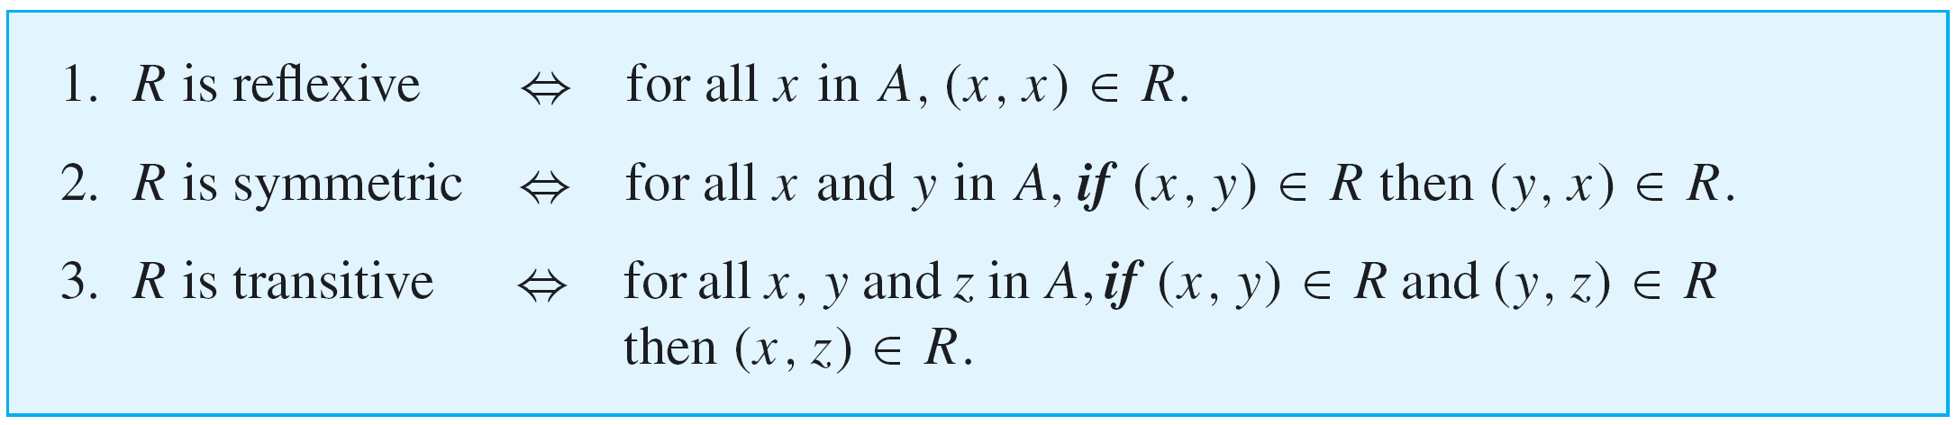
Reflexivity, Symmetry, and Transitivity
Because of the equivalence of the expressions x R y and (x, y) ∈ R for all x and y in A, the reflexive, symmetric, and transitive properties can also be written as follows:

Slide 7
Reflexivity, Symmetry, and Transitivity
In informal terms, properties (1)–(3) say the following:
1. Reflexive: Each element is related to itself.
2. Symmetric: If any one element is related to any other element, then the second element is related to the first.
3. Transitive: If any one element is related to a second and that second element is related to a third, then the first element is related to the third.
Note that the definitions of reflexivity, symmetry, and transitivity are universal statements.

Slide 8


Reflexivity, Symmetry, and Transitivity
This means that to prove a relation has one of the properties, you use either the method of exhaustion or the method of generalizing from the generic particular.
Now consider what it means for a relation not to have one of the properties defined previously. We have known that the negation of a universal statement is existential.
Hence if R is a relation on a set A, then
1. R is not reflexive ⇔ there is an element x in A such
that [that is, such that
(x, x) R].

Slide 9


Reflexivity, Symmetry, and Transitivity
2. R is not symmetric ⇔ there are elements x and y in A such that x R y but
[that is, such that
(x, y) ∈ R but (y, x) R].
3. R is not transitive ⇔ there are elements x, y and z in A such that x R y and
y R z but [that is, such that (x, y) ∈ R and
(y, z) ∈ R but (x, z) R].
It follows that you can show that a relation does not have one of the properties by finding a counterexample.

Slide 10
Example 1 – Properties of Relations on Finite Sets
Let A = {0, 1, 2, 3} and define relations R, S, and T on A as follows:
R = {(0, 0), (0, 1), (0, 3), (1, 0), (1, 1), (2, 2), (3, 0), (3, 3)},
S = {(0, 0), (0, 2), (0, 3), (2, 3)},
T = {(0, 1), (2, 3)}.
a. Is R reflexive? symmetric? transitive?
b. Is S reflexive? symmetric? transitive?
c. Is T reflexive? symmetric? transitive?

Slide 11
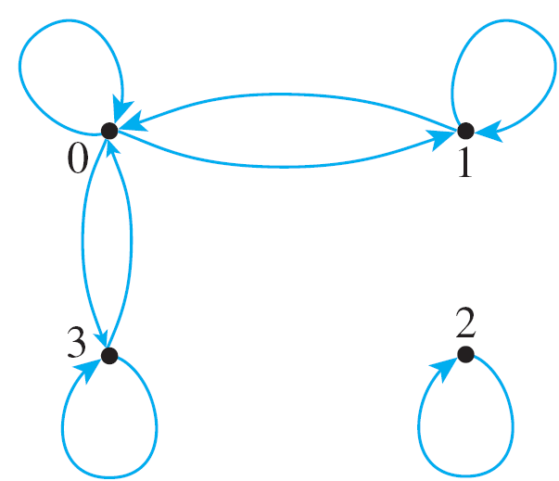
Example 1(a) – Solution
The directed graph of R has the appearance shown below.
R is reflexive: There is a loop at each point of the directed graph. This means that each element of A is related to itself, so R is reflexive.

Slide 12
Example 1(a) – Solution
cont’d
R is symmetric: In each case where there is an arrow going from one point of the graph to a second, there is an arrow going from the second point back to the first.
This means that whenever one element of A is related by R to a second, then the second is related to the first. Hence R is symmetric.
R is not transitive: There is an arrow going from 1 to 0 and an arrow going from 0 to 3, but there is no arrow going from 1 to 3.
This means that there are elements of A—0, 1, and
3—such that 1 R 0 and 0 R 3 but 1 3. Hence R is not transitive.

Slide 13
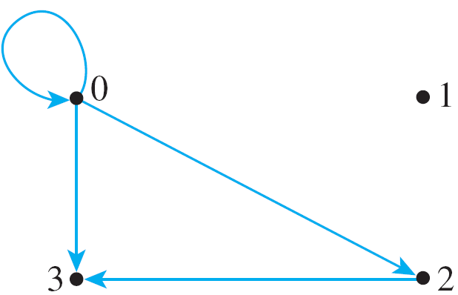
Example 1(b) – Solution
cont’d
The directed graph of S has the appearance shown below.
S is not reflexive: There is no loop at 1, for example.
Thus (1, 1) S, and so S is not reflexive.
S is not symmetric: There is an arrow from 0 to 2 but not from 2 to 0. Hence (0, 2) ∈ S but (2, 0) S, and so S is not symmetric.

Slide 14
Example 1(b) – Solution
cont’d
S is transitive: There are three cases for which there is an arrow going from one point of the graph to a second and from the second point to a third:
Namely, there are arrows going from 0 to 2 and from 2 to 3; there are arrows going from 0 to 0 and from 0 to 2; and there are arrows going from 0 to 0 and from 0 to 3.
In each case there is an arrow going from the first point to the third. (Note again that the “first,” “second,” and “third” points need not be distinct.)
This means that whenever (x, y) ∈ S and (y, z) ∈ S, then (x, z) ∈ S, for all x, y, z ∈ {0, 1, 2, 3}, and so S is transitive.

Slide 15


Example 1(c) – Solution
cont’d
The directed graph of T has
the appearance shown at right.
T is not reflexive: There is no loop at 0, for example. Thus (0, 0) T, so T is not reflexive.
T is not symmetric: There is an arrow from 0 to 1 but not from 1 to 0. Thus (0, 1) ∈ T but (1, 0) T, and so T is not symmetric.
T is transitive: The transitivity condition is vacuously true for T. To see this, observe that the transitivity condition says that
For all x, y, z ∈ A, if (x, y) ∈ T and (y, z) ∈ T then (x, z) ∈ T.

Slide 16
Example 1(c) – Solution
cont’d
The only way for this to be false would be for there to exist elements of A that make the hypothesis true and the conclusion false.
That is, there would have to be elements x, y, and z in A such that (x, y) ∈ T and (y, z) ∈ T and (x, z) T.
In other words, there would have to be two ordered pairs in T that have the potential to “link up” by having the second element of one pair be the first element of the other pair.
But the only elements in T are (0, 1) and (2, 3), and these do not have the potential to link up. Hence the hypothesis is never true. It follows that it is impossible for T not to be transitive, and thus T is transitive.

Slide 17
Properties of Relations on
Infinite Sets

Slide 18
Properties of Relations on Infinite Sets
Suppose a relation R is defined on an infinite set A. To prove the relation is reflexive, symmetric, or transitive, first write down what is to be proved. For instance, for symmetry you need to prove that
∀ x, y ∈ A, if x R y then y R x.
Then use the definitions of A and R to rewrite the statement for the particular case in question. For instance, for the “equality” relation on the set of real numbers, the rewritten statement is
∀ x, y ∈ R, if x = y then y = x.

Slide 19
Properties of Relations on Infinite Sets
Sometimes the truth of the rewritten statement will be immediately obvious (as it is here).
At other times you will need to prove it using the method of generalizing from the generic particular.
We begin with the relation of equality, one of the simplest and yet most important relations.

Slide 20
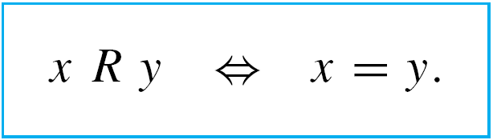
Example 2 – Properties of Equality
Define a relation R on R (the set of all real numbers) as follows: For all real numbers x and y.
a. Is R reflexive?
b. Is R symmetric?
c. Is R transitive?

Slide 21
Example 2(a) – Solution
R is reflexive: R is reflexive if, and only if, the following statement is true:
For all x ∈ R, x R x.
Since x R x just means that x = x, this is the same as saying
For all x ∈ R, x = x.
But this statement is certainly true; every real number is equal to itself.

Slide 22
Example 2(b) – Solution
cont’d
R is symmetric: R is symmetric if, and only if, the following statement is true:
For all x, y ∈ R, if x R y then y R x.
By definition of R, x R y means that x = y and y R x means that y = x. Hence R is symmetric if, and only if,
For all x, y ∈ R, if x = y then y = x.
But this statement is certainly true; if one number is equal to a second, then the second is equal to the first.

Slide 23
Example 2(c) – Solution
cont’d
R is transitive: R is transitive if, and only if, the following statement is true:
For all x, y, z ∈ R, if x R y and y R z then x R z.
By definition of R, x R y means that x = y, y R z means that y = z, and x R z means that x = z. Hence R is transitive if, and only if, the following statement is true:
For all x, y, z ∈ R, if x = y and y = z then x = z.
But this statement is certainly true: If one real number equals a second and the second equals a third, then the first equals the third.

Slide 24
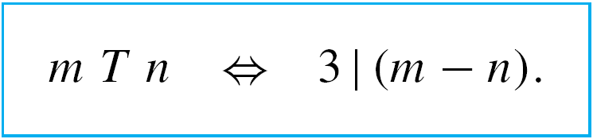
Example 4 – Properties of Congruence Modulo 3
Define a relation T on Z (the set of all integers) as follows: For all integers m and n,
This relation is called congruence modulo 3.
a. Is T reflexive?
b. Is T symmetric?
c. Is T transitive?

Slide 25
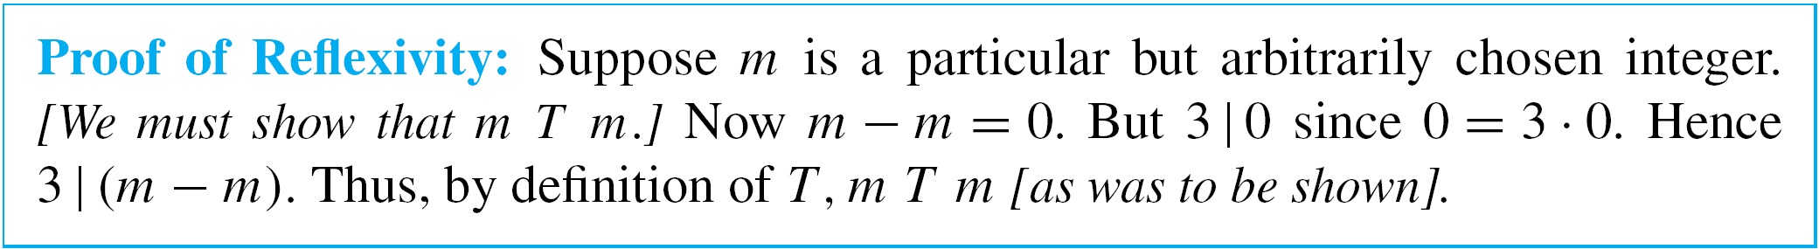
Example 4(a) – Solution
T is reflexive: To show that T is reflexive, it is necessary to show that
For all m ∈ Z, m T m.
By definition of T, this means that
For all m ∈ Z, 3 | (m – m).
Or, since m – m = 0, For all m ∈ Z, 3 | 0.
But this is true: 3 | 0 since 0 = 3  0. Hence T is reflexive. This reasoning is formalized in the following proof.

Slide 26
Example 4(b) – Solution
cont’d
T is symmetric: To show that T is symmetric, it is necessary to show that
For all m, n ∈ Z, if m T n then n T m.
By definition of T this means that
For all m, n ∈ Z, if 3 | (m – n) then 3 | (n – m).
Is this true? Suppose m and n are particular but arbitrarily chosen integers such that 3 | (m – n).
Must it follow that 3 | (n – m)? [In other words, can we find an integer so that n – m = 3  (that integer)?]

Slide 27
Example 4(b) – Solution
cont’d
By definition of “divides,” since
3 | (m – n),
then m – n = 3k for some integer k.
The crucial observation is that n – m = –(m – n). Hence, you can multiply both sides of this equation by –1 to obtain
–(m – n) = –3k,
which is equivalent to n – m = 3(–k).
[Thus we have found an integer, namely –k, so that
n – m = 3  (that integer).]

Slide 28
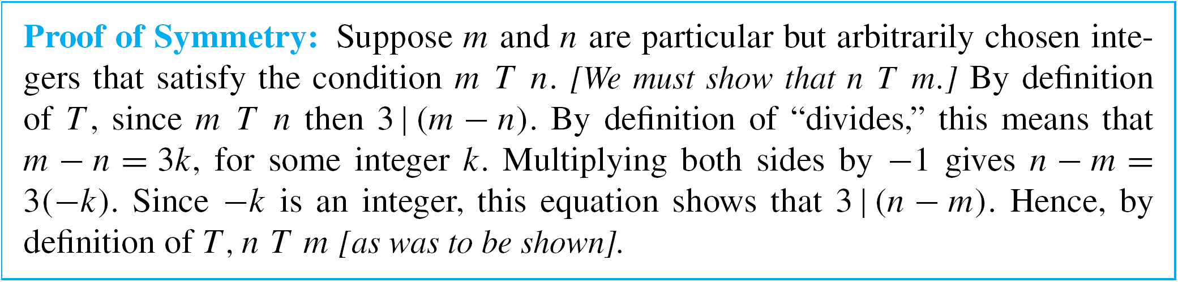
Example 4(b) – Solution
cont’d
Since –k is an integer, this equation shows that
3 | (n – m).
It follows that T is symmetric.
The reasoning is formalized in the following proof.

Slide 29
Example 4(c) – Solution
cont’d
T is transitive: To show that T is transitive, it is necessary to show that
For all m, n, p ∈ Z, if m T n and n T p then m T p.
By definition of T this means that
For all m, n ∈ Z,
if 3 | (m – n) and 3 | (n – p) then 3 | (m – p).
Is this true? Suppose m, n, and p are particular but arbitrarily chosen integers such that 3 | (m – n) and
3 | (n – p).
Must it follow that 3 | (m – p)? [In other words, can we find an integer so that m – p = 3  (that integer)?]

Slide 30
Example 4(c) – Solution
cont’d
By definition of “divides,” since
3 | (m – n) and 3 | (n – p),
then m – n = 3r for some integer r,
and n – p = 3s for some integer s.
The crucial observation is that (m – n) + (n – p) = m – p.
Add these two equations together to obtain
(m – n) + (n – p) = 3r + 3s,
which is equivalent to m – p = 3(r + s).
[Thus we have found an integer so that m – p = 3  (that integer).]

Slide 31
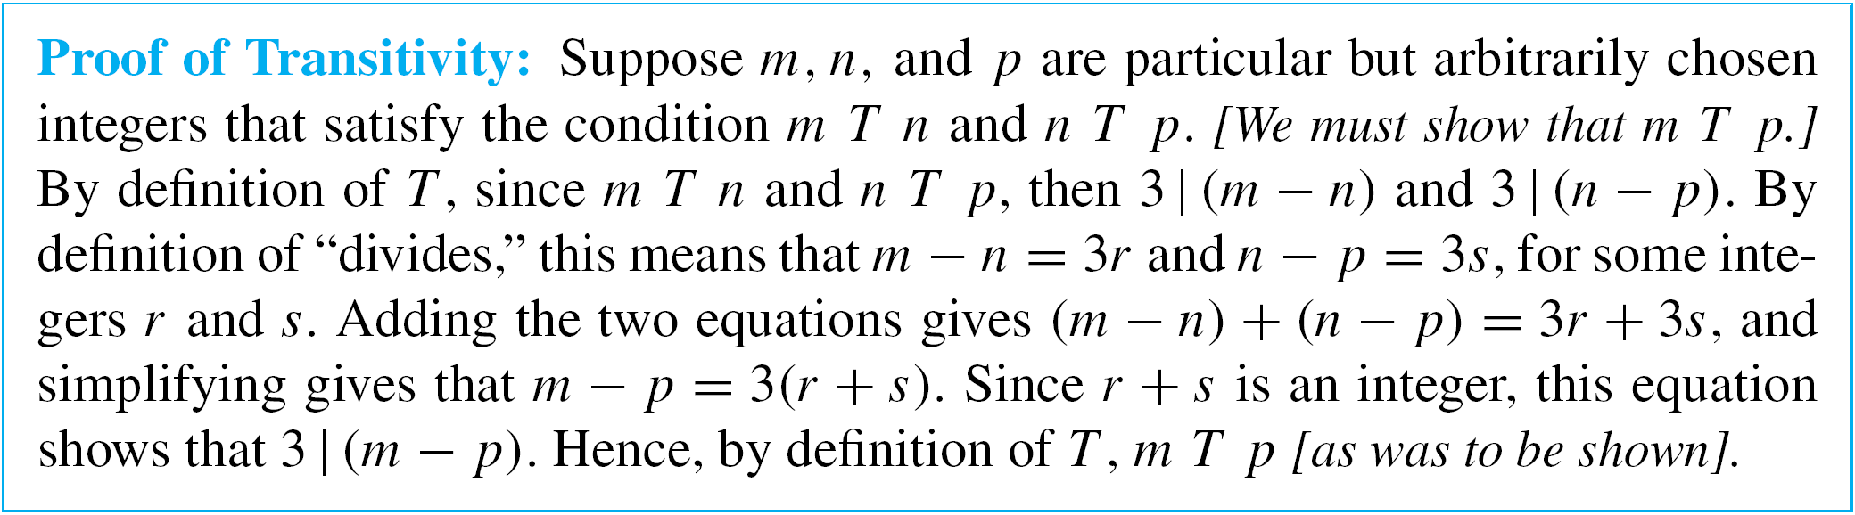
Example 4(c) – Solution
cont’d
Since r and s are integers, r + s is an integer. So this equation shows that
3 | (m – p).
It follows that T is transitive.
The reasoning is formalized in the following proof.

Slide 32
The Transitive Closure of a Relation

Slide 33
The Transitive Closure of a Relation
Generally speaking, a relation fails to be transitive because it fails to contain certain ordered pairs.
For example, if (1, 3) and (3, 4) are in a relation R, then the pair (1, 4) must be in R if R is to be transitive.
To obtain a transitive relation from one that is not transitive, it is necessary to add ordered pairs.
Roughly speaking, the relation obtained by adding the least number of ordered pairs to ensure transitivity is called the transitive closure of the relation.

Slide 34
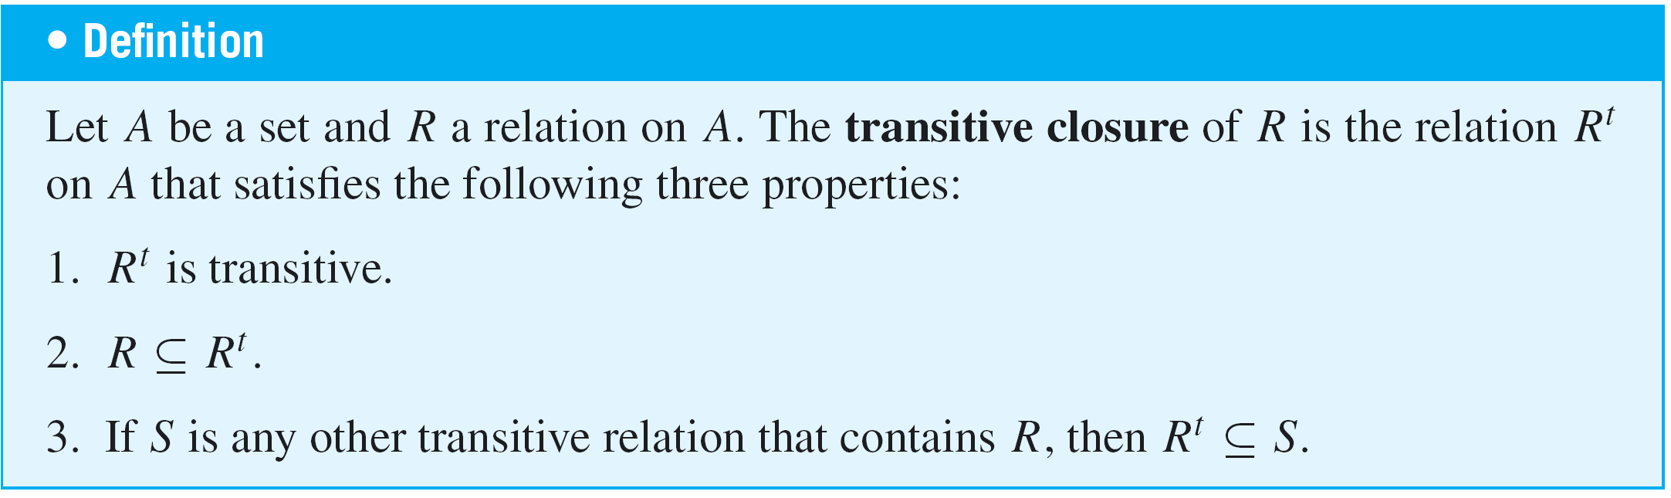
The Transitive Closure of a Relation
In a sense made precise by the formal definition, the transitive closure of a relation is the smallest transitive relation that contains the relation.

Slide 35
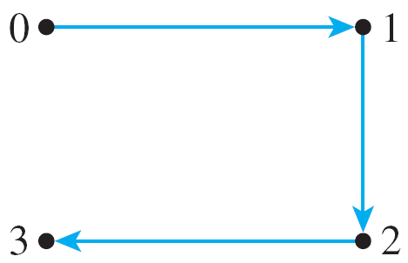
Example 5 – Transitive Closure of a Relation
Let A = {0, 1, 2, 3} and consider the relation R defined on A as follows:
R = {(0, 1), (1, 2), (2, 3)}.
Find the transitive closure of R.
Solution:
Every ordered pair in R is in R ^{t}, so
{(0, 1), (1, 2), (2, 3)} ⊆ R ^{t}.
Thus the directed graph of R contains
the arrows shown at the right.

Slide 36
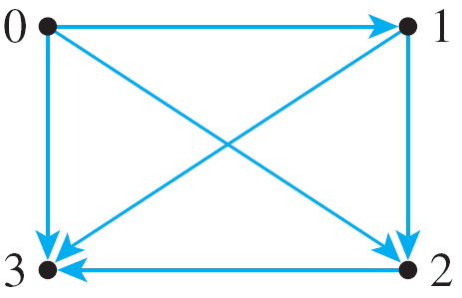
Example 5 – Solution
cont’d
Since there are arrows going from 0 to 1 and from 1 to 2,
R ^{t} must have an arrow going from 0 to 2.
Hence (0, 2) ∈ R ^{t}. Then (0, 2) ∈ R ^{t} and (2, 3) ∈ R ^{t}, so since R ^{t} is transitive, (0, 3) ∈ R ^{t}.
Also, since (1, 2) ∈ R ^{t} and (2, 3) ∈ R ^{t}, then (1, 3) ∈ R ^{t}.
Thus R ^{t} contains at least the following ordered pairs:
{(0, 1), (0, 2), (0, 3), (1, 2), (1, 3), (2, 3)}.
But this relation is transitive; hence it
equals R ^{t}. Note that the directed graph
of R ^{t} is as shown at the right.

